Slide 1




JFEATURE
Know Your Corpus !
Idriss Riouak, Görel Hedin, Christoph Reichenbach, and Niklas Fors
Computer Science Department, Lund University, Sweden.

Slide 2
Tool evaluation: why and how ?
Why ?
Measure how well our tool perform
Convince the reader that our tool is fast and precise
How ?
Software Corpus

Slide 3
What is a software corpus ?
Collection of software projects
Fixed version
Targeting a specific programming language, e.g., Java, C++
Source-code or bytecode
Constructed for a particular purpose:
Testing specific properties, e.g., heavy use of concurrency
Complex control-flow

Slide 4
Problem: Which corpus should we use for the evaluation of our tool?
IT DEPENDS
The kind of artefact
Static or Dynamic analyser
Compiler Front-end or Back-end
ML-based application
What we want to evaluate ?
Performance
Precision
…
Language version:
Java 8 or 11 or 19 ?
C98 or C11
This list can continue forever
…

Slide 5

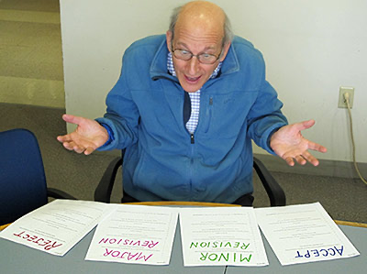

Problem: In other words …
The corpus you are using for the evaluation

Slide 6
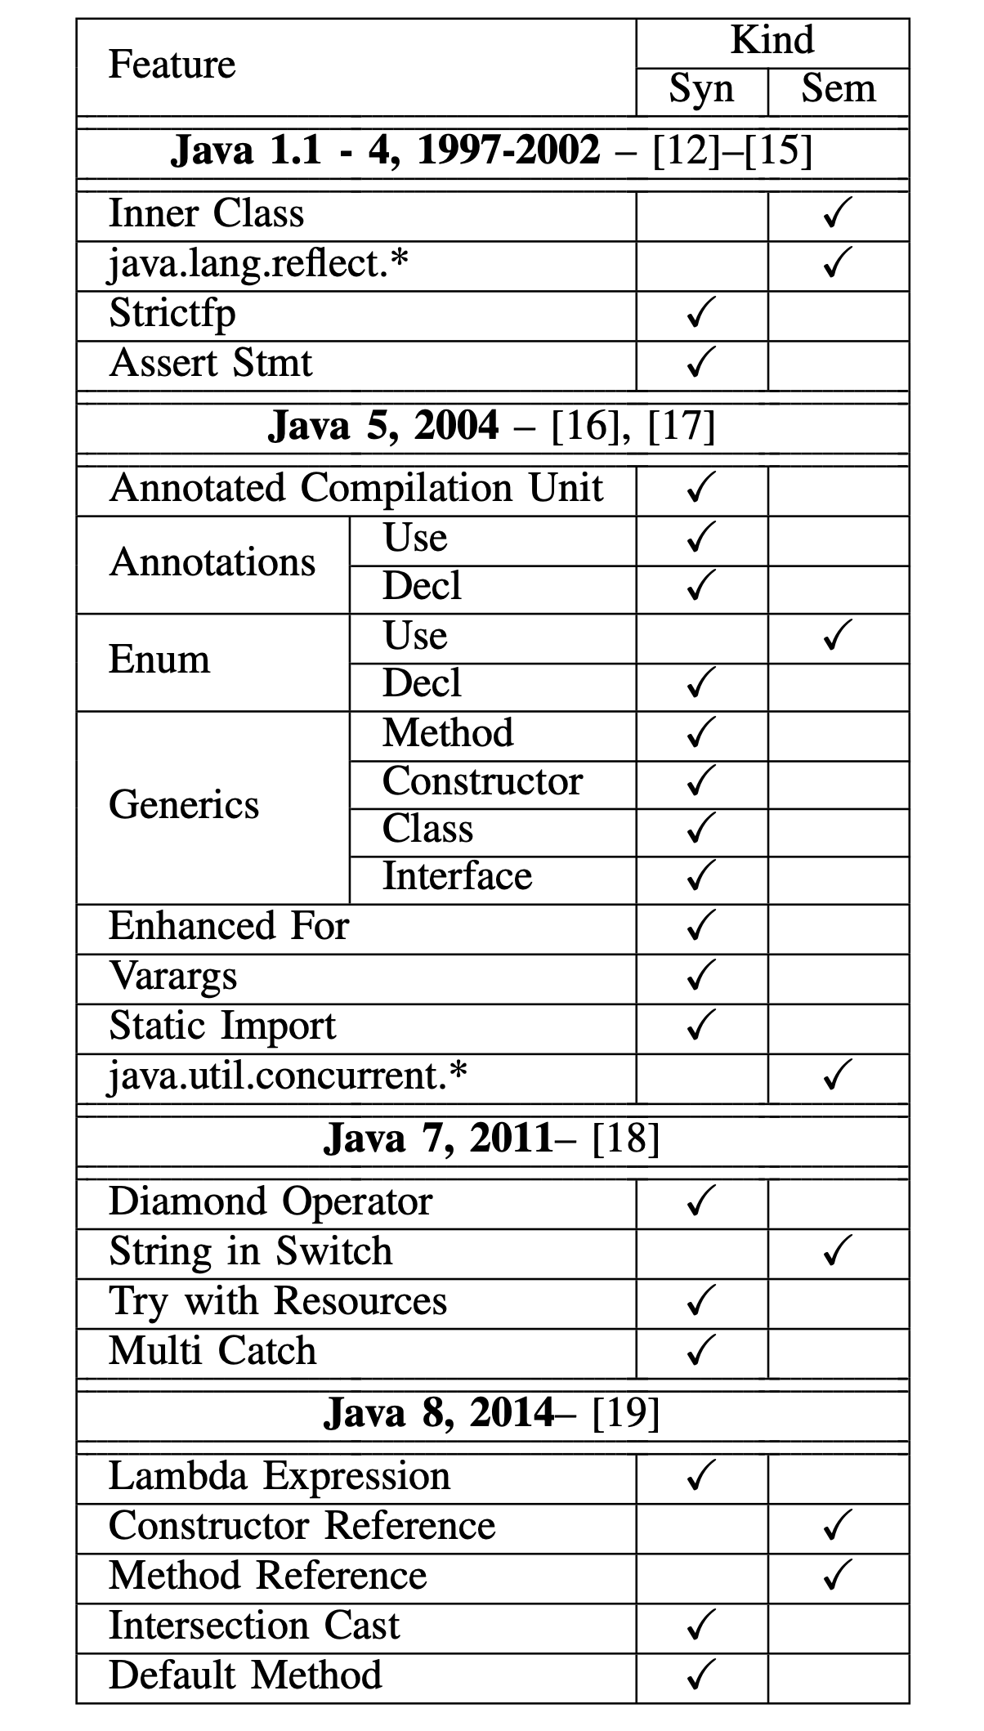
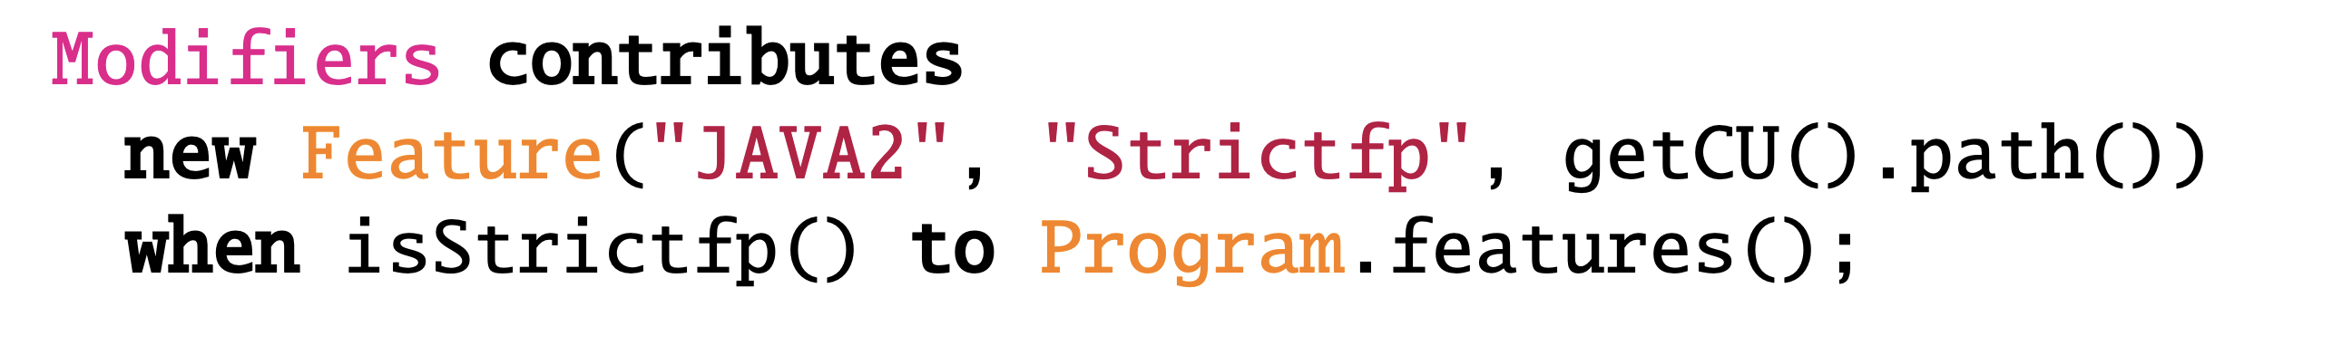
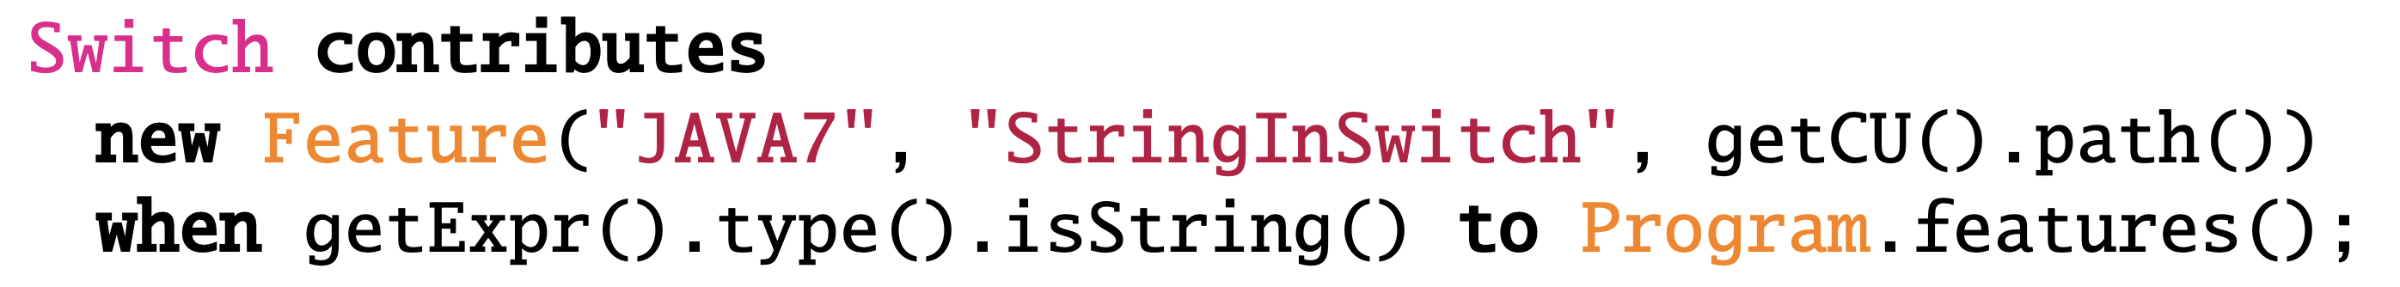
JFeature Decision support for selecting benchmarks for specific research questions for Java
Extract how often a Java feature is used
Analyse the source code
Declarative specification
Syntactic and semantic features (anything a compiler can typically compute)
Extensible

Slide 7
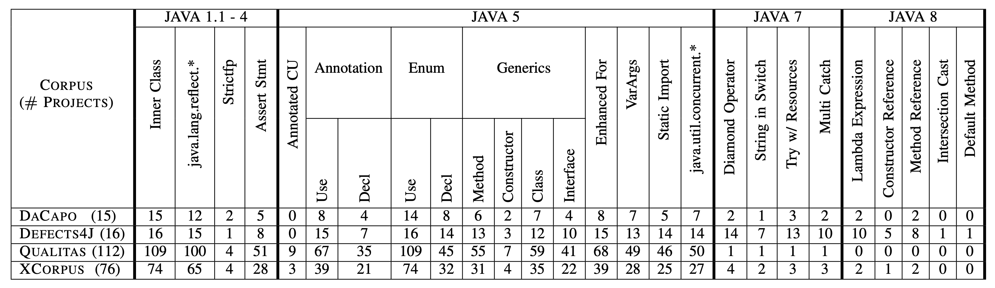
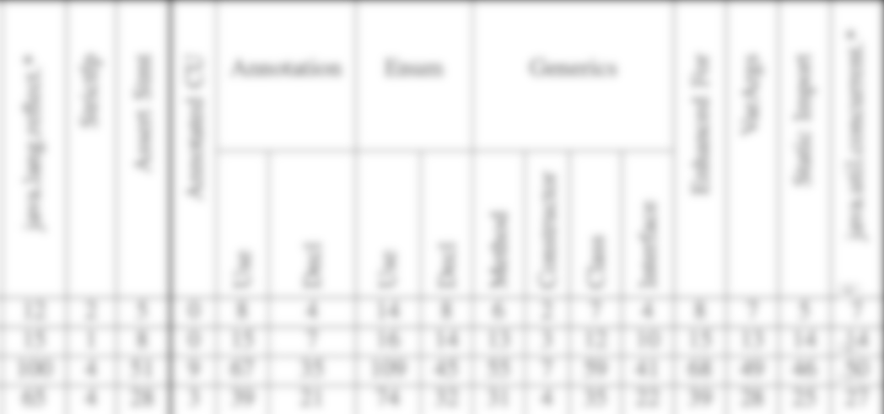
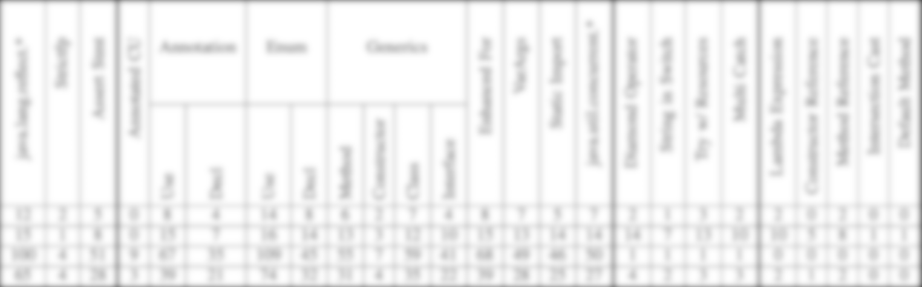


Empirical results On four well-known Java corpora
DaCapo
Performance
# Projects: 15
Defects4J
Static Analysis
# Projects: 16
XCorpus
Dynamic Language Feature
# Projects: 76
Qualitas Corpus
Static Analysis
# Projects: 112
More fine grained results in our paper

Slide 8
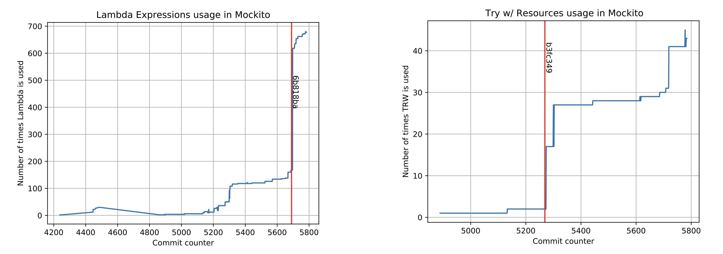
JFeature: Other possible applications
Longitudinal studies: using JFeature to create new corpus
Notes:
Longitudinal studies instead of GH

Slide 9

Conclusions
JFeature: a decision support tool for selecting corpora
Empirical study on four well-known corpora
Take away
Use Defects4j to evaluate your Java 7 or Java 8 application.
Check if the corpus fits with your research questions
If not, build your own corpus.
Thank you!
Notes:
Rewrite first sentence in Take Away.

Slide 10

Provocative Questions/Statements
YOU ARE NOT SELECTING CORPORA SYSTEMATICALLY!!!
Which feature would you extract for your tool?
Java is evolving to fast! This is not fun for us! How should we create new corpora to evaluate newer Java versions? Incrementally ?

Slide 11
Provocative Questions/Statements
How do you choose a corpus? What is your SYSTEMATIC approach for selecting it ?
Which feature would you extract for your tool?
Java is evolving to fast! This is not fun for us! How should we create new corpora to evaluate newer Java versions? Incrementally ?

